Slide 1
THE SAGE TEST Student Assessment Of Growth and Excellence
All You Need To Know!
Just Remember To
Bring Your Own Brain!

Slide 2
SAGE TEST INFORMATION (Revised to Include 2016 Updates)
Table of Contents
Signing In: Slides 3-4
Test Selection: Slide 5
Test Instructions: Slides 6-7
Navigation Tools: Slides 8-10
Settings: Slides 11-12
Test Confirmation: Slide 13
Missing Answer Reminder: Slide 14
Test Submission: Slides 15-17
Writing Test: Slides 18-20
Math Test: Slides 21 – 32
Reading, Language, and Listening Tests: Slides 33-44
Science Test: Slides 45-55
Test-Taking Tips: Slides 56-59
The following slides are meant to help students and teachers become more familiar and comfortable with navigating through the SAGE Test Site. All screenshots are from the Practice Test using the “Guest” login.

Slide 3
Signing In To The Test!

Slide 4
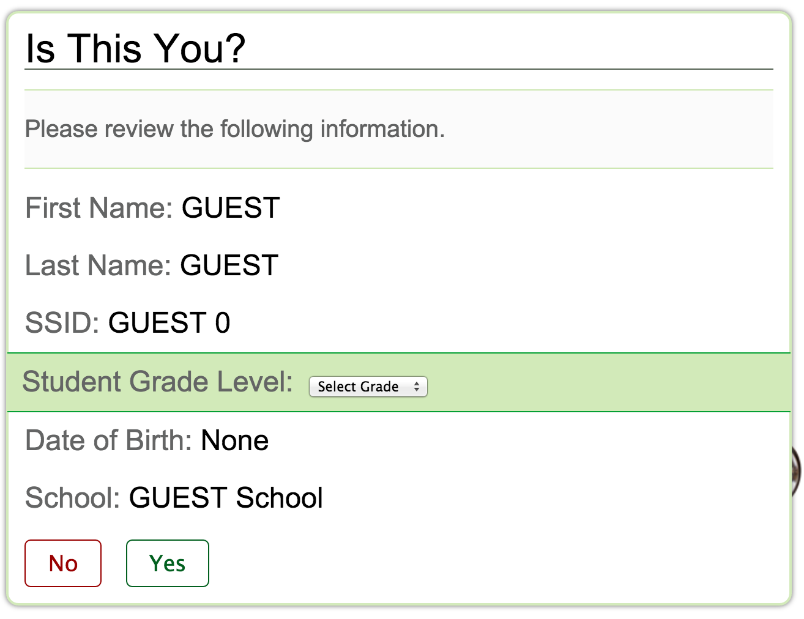

Slide 5
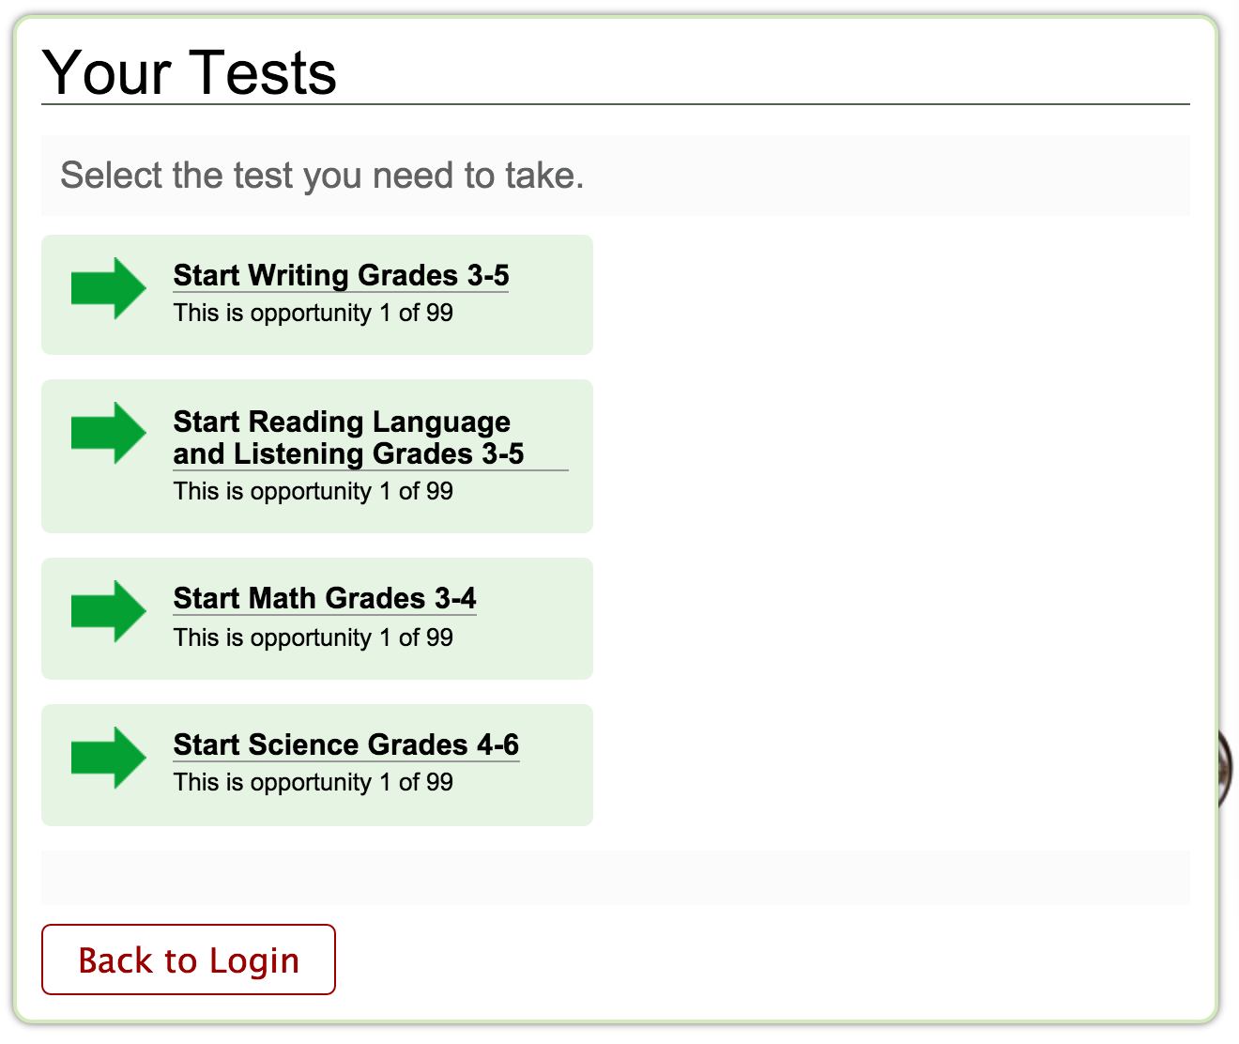
Test Selection!
Click on a Test!

Slide 6
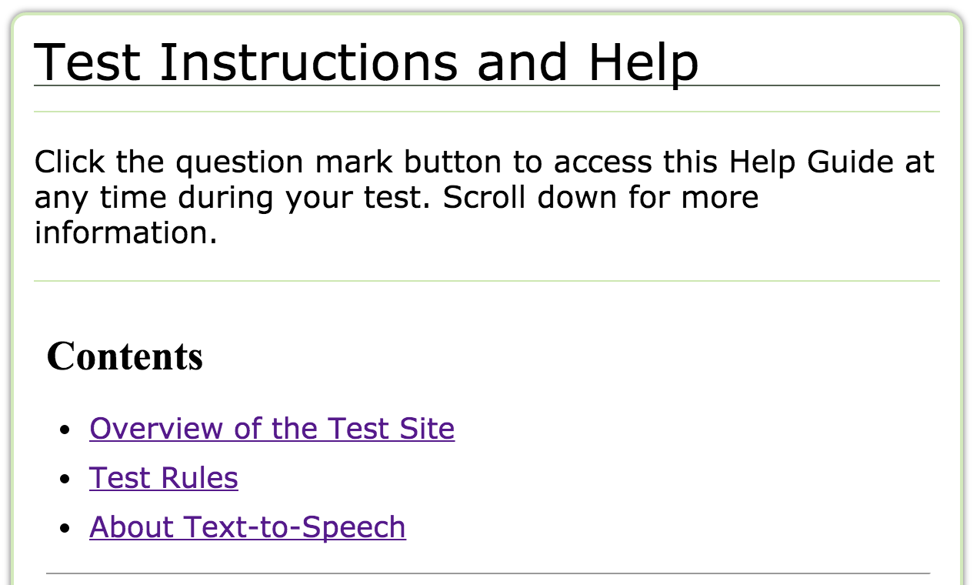
Helpful Clickable Links

Slide 7
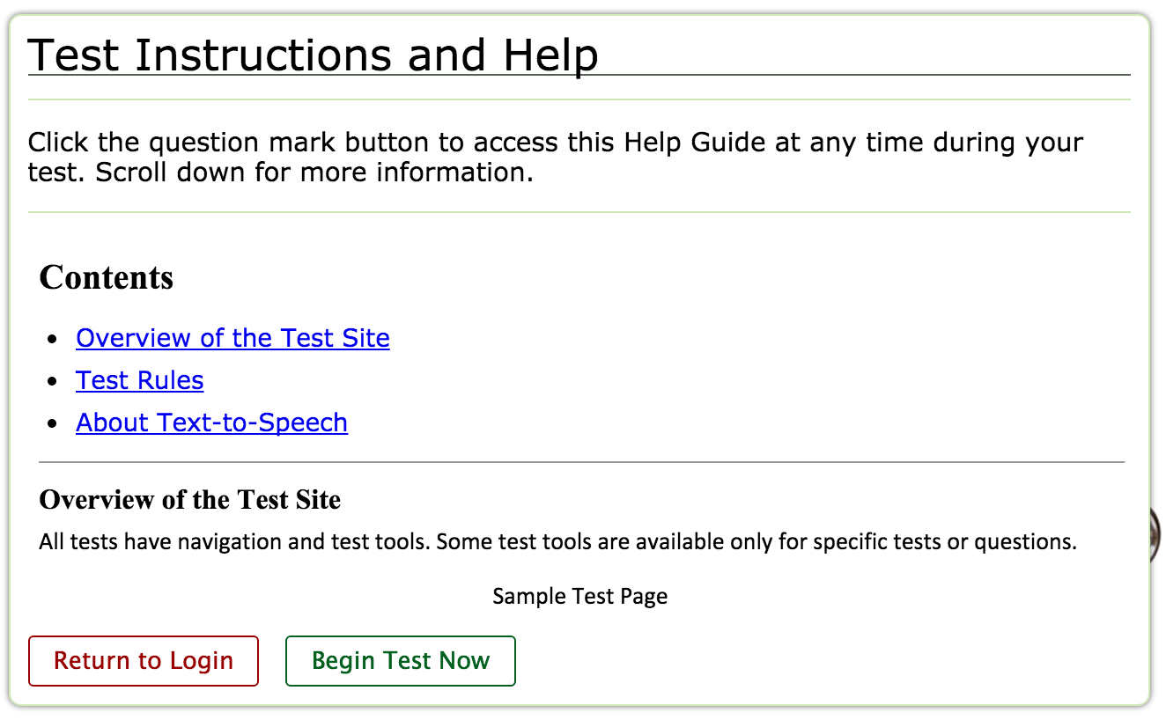

Slide 8
Navigation Tools

Slide 9
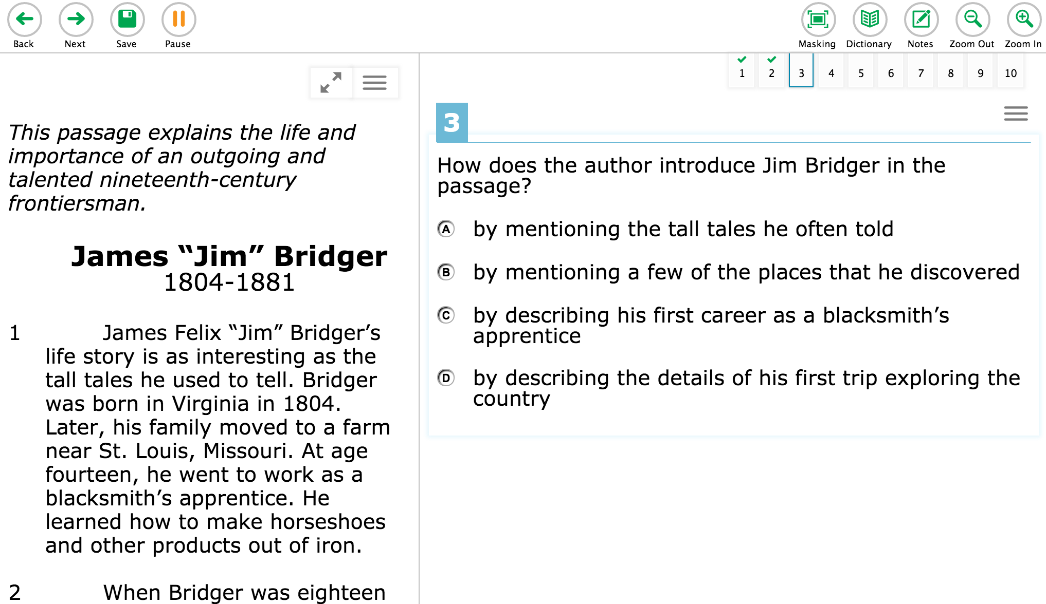
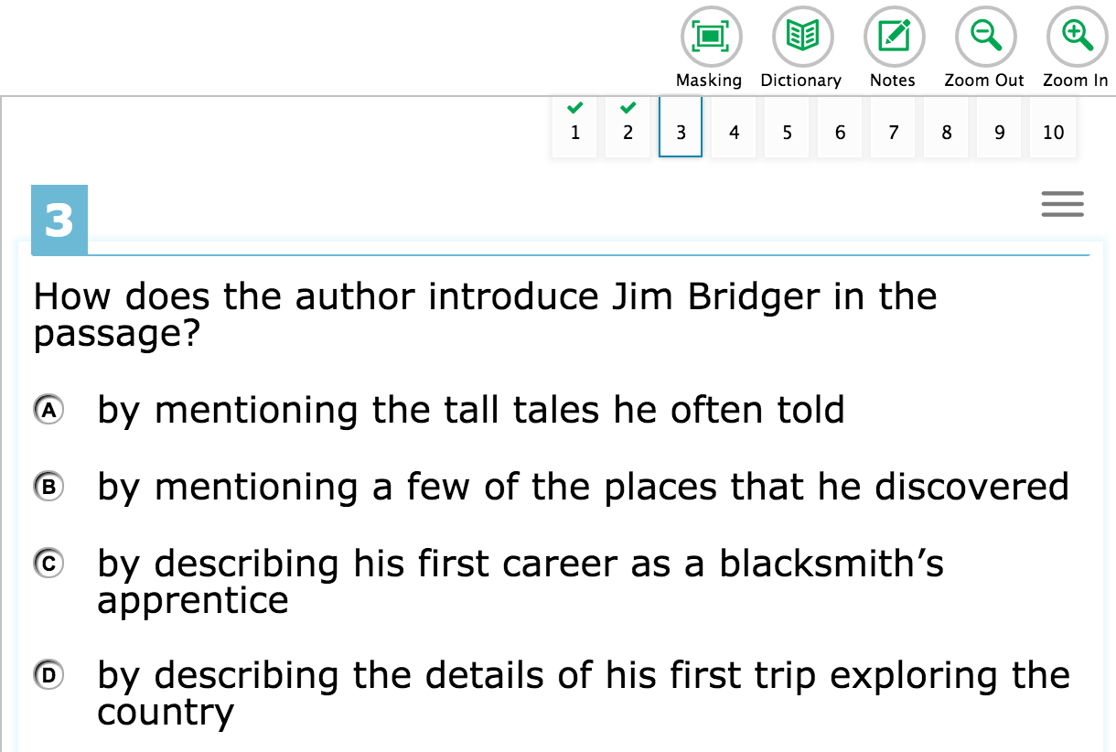
Navigation Tools!

Slide 10
You will see this “Attention” screen pop up when you are all finished with the test section.
Click the “OK” button.
Then click the “End” button.

Slide 11
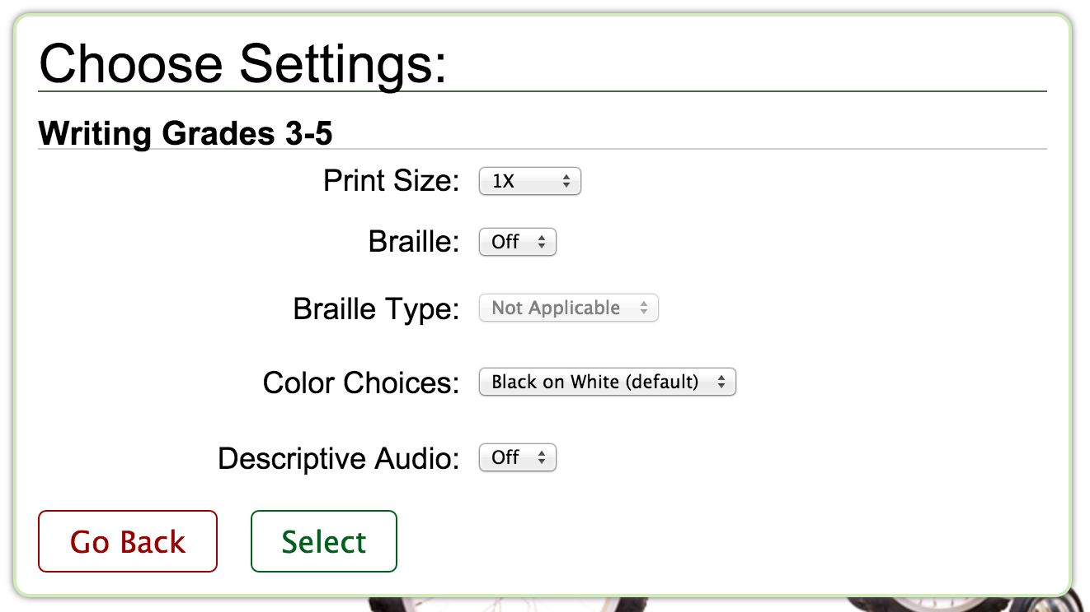
Choose Settings With Teacher’s Permission Only!

Slide 12
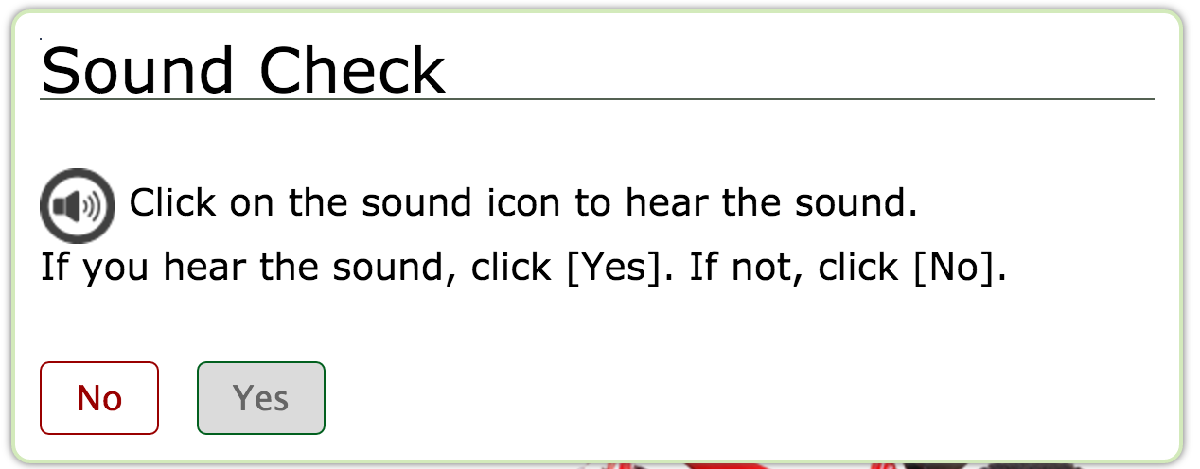
Be Sure to Check the Sound Before You Begin!

Slide 13
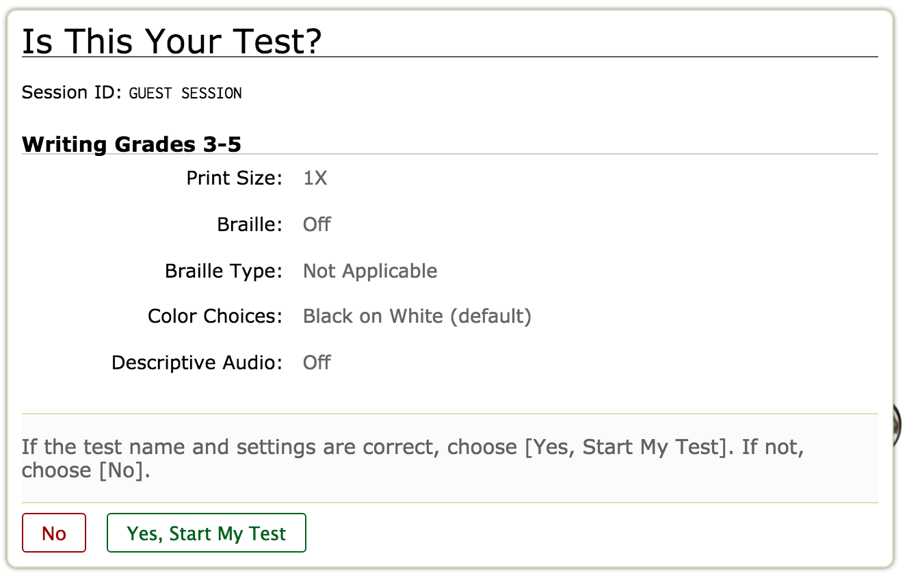
Test Confirmation

Slide 14
If you see this…you have missed answering a question and you won’t be able to move on until you do so.

Slide 15
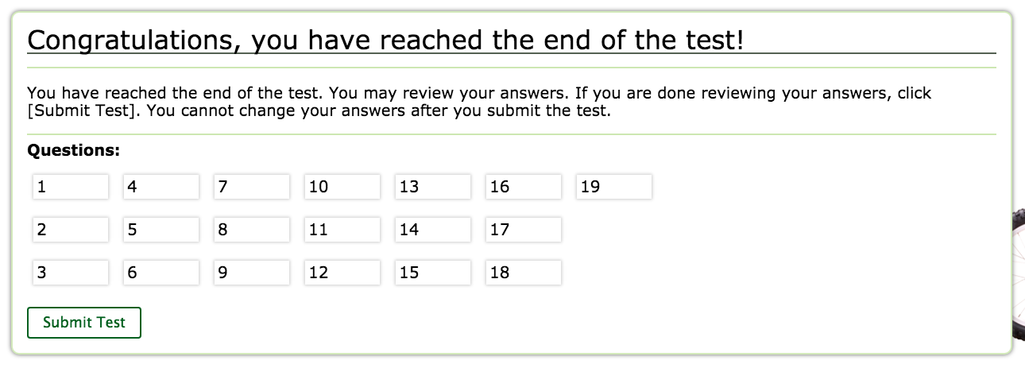
When ready to submit, click the “Submit Test” button.

Slide 16
Don’t Submit Unless You Check and Re-Check Your Work!

Slide 17
Results will be given immediately… EXCEPT for the Writing Test!

Slide 18
The Writing Test

Slide 19
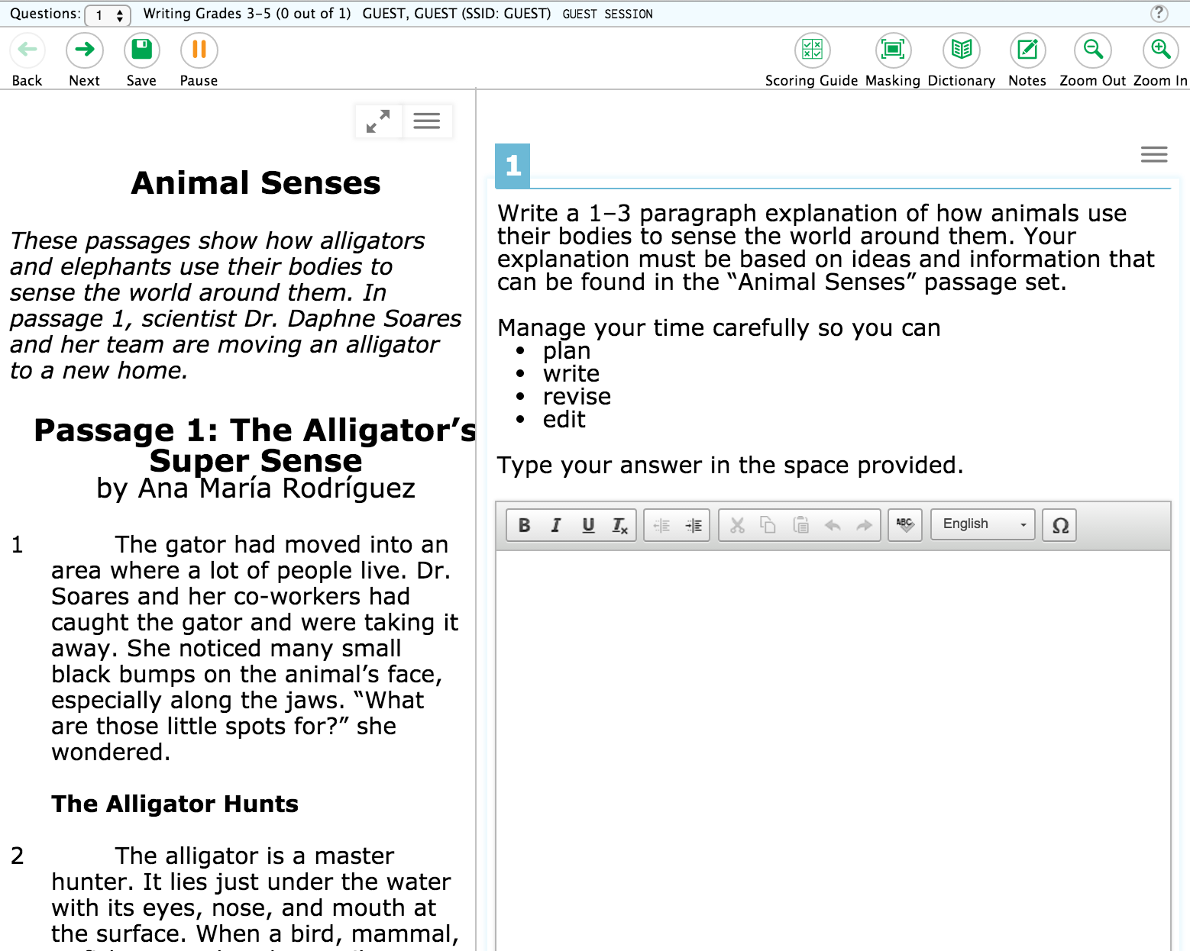
Click on the arrows to show just the passage.
Click on the arrows to return to the split screen

Slide 20
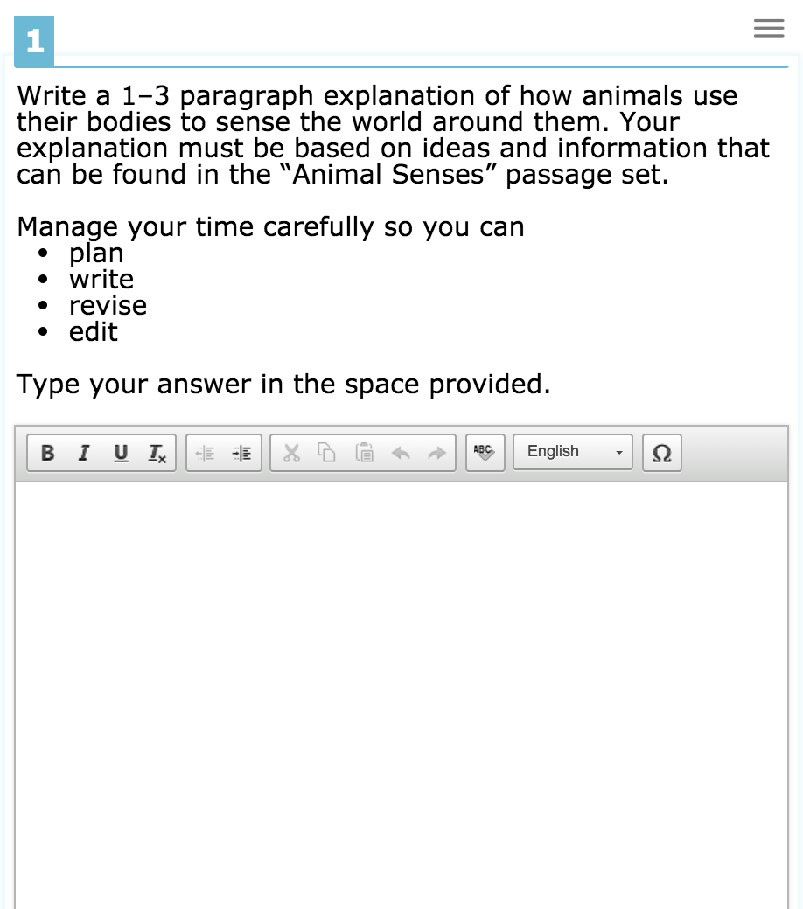
Manage your time: Plan, Write, Revise, Edit

Slide 21
The Math Test

Slide 22
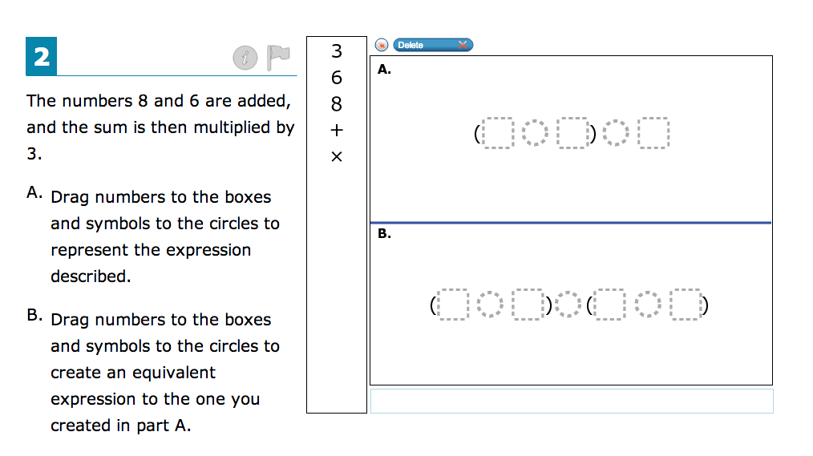
Drag and Drop!

Slide 23
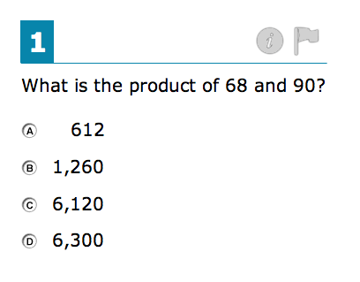
Single Answer Questions!

Slide 24
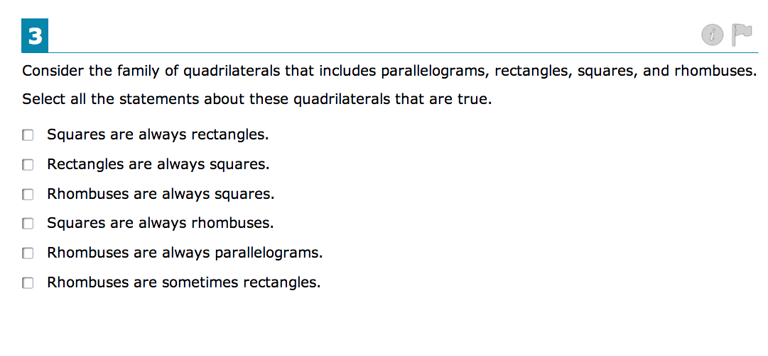
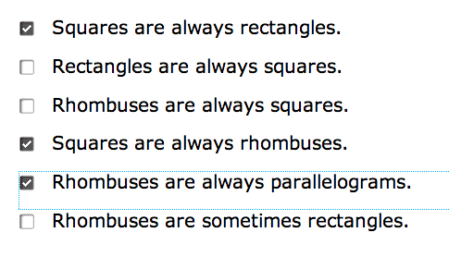
Multiple Answer Questions!

Slide 25
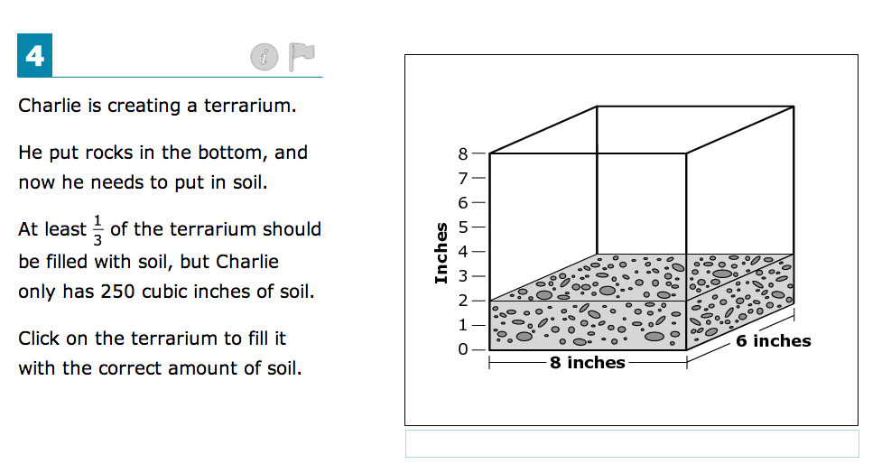
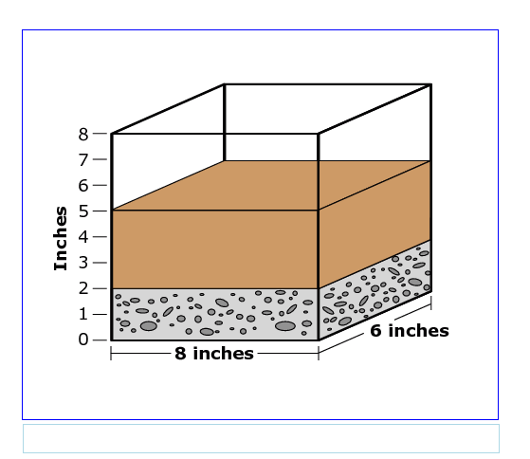
Interactive Questions!
Here you click on the terrarium and fill the tank.

Slide 26
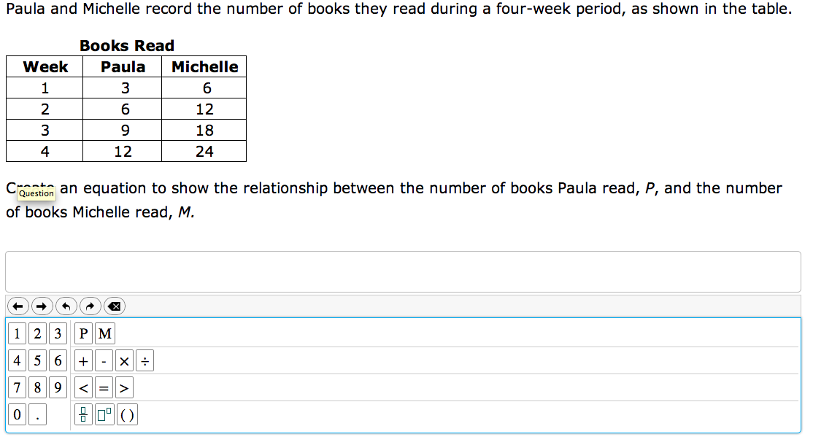
Choose and Click!
Notice the tools that are available:

Slide 27
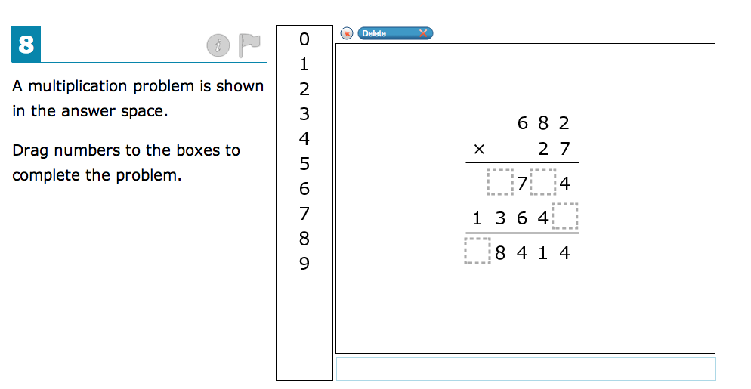
Drag and drop the numbers into the correct position.

Slide 28
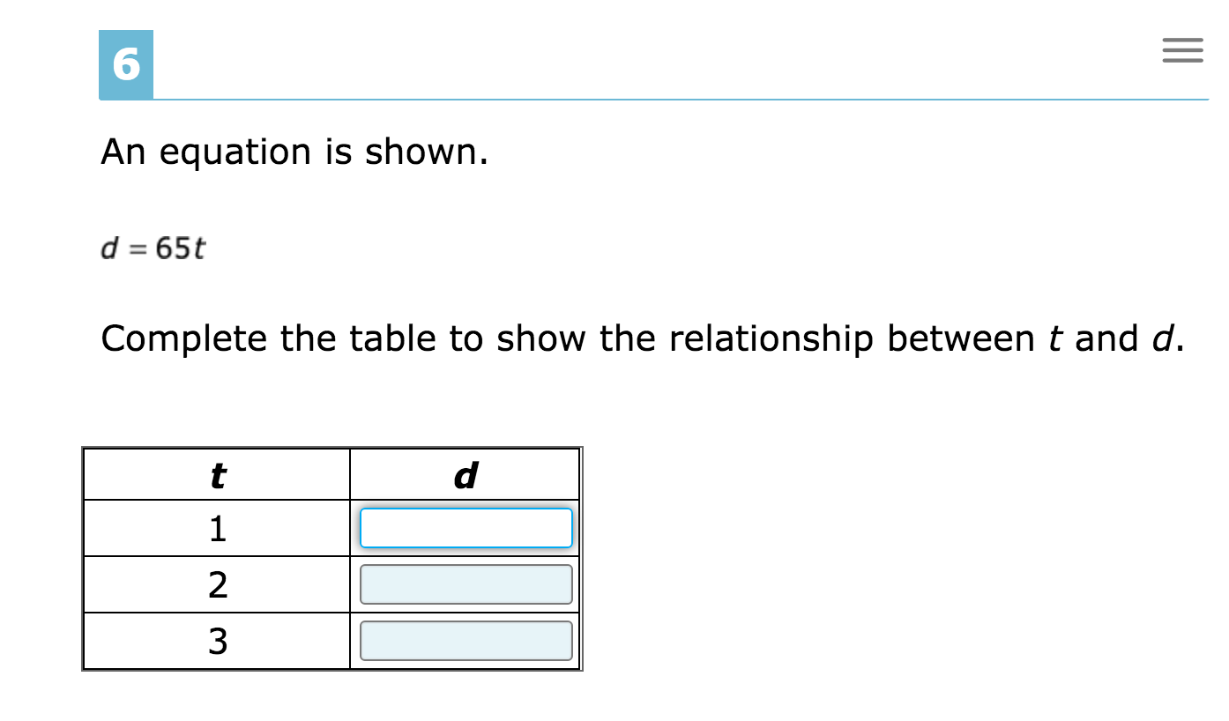
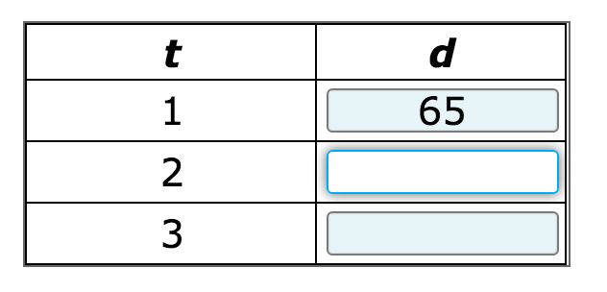
New! Fill-in-the-Blank Questions

Slide 29
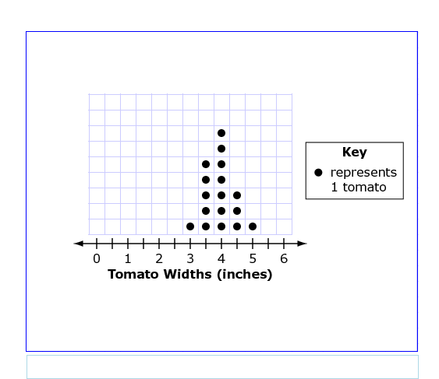
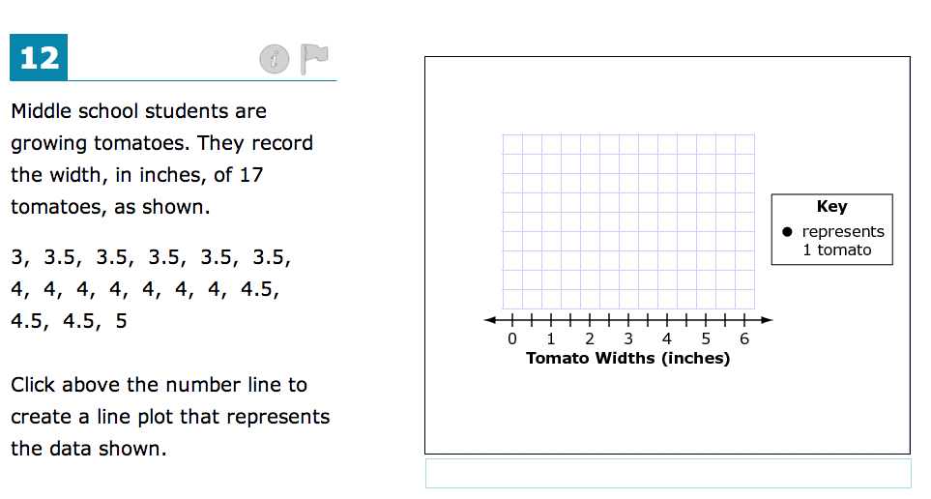
Click and Plot the Graph!

Slide 30
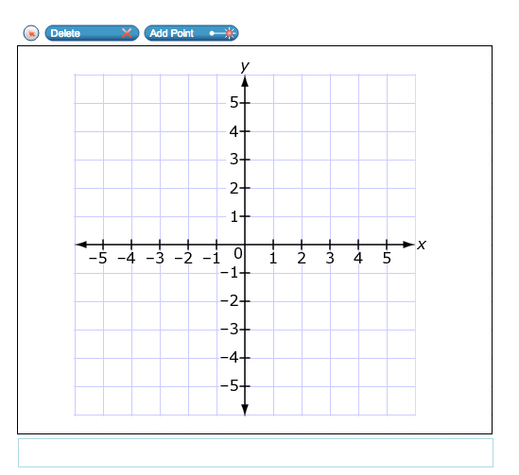
Notice the “Delete” and “Add Point” Tools.

Slide 31
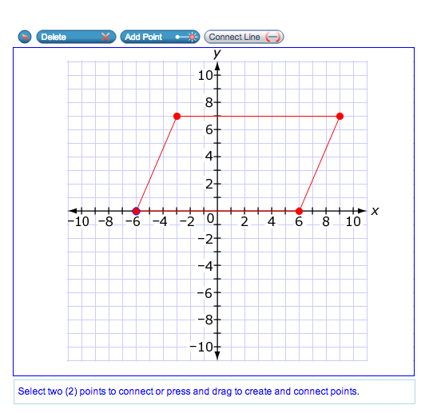
Notice the “Connect Line” Tool

Slide 32
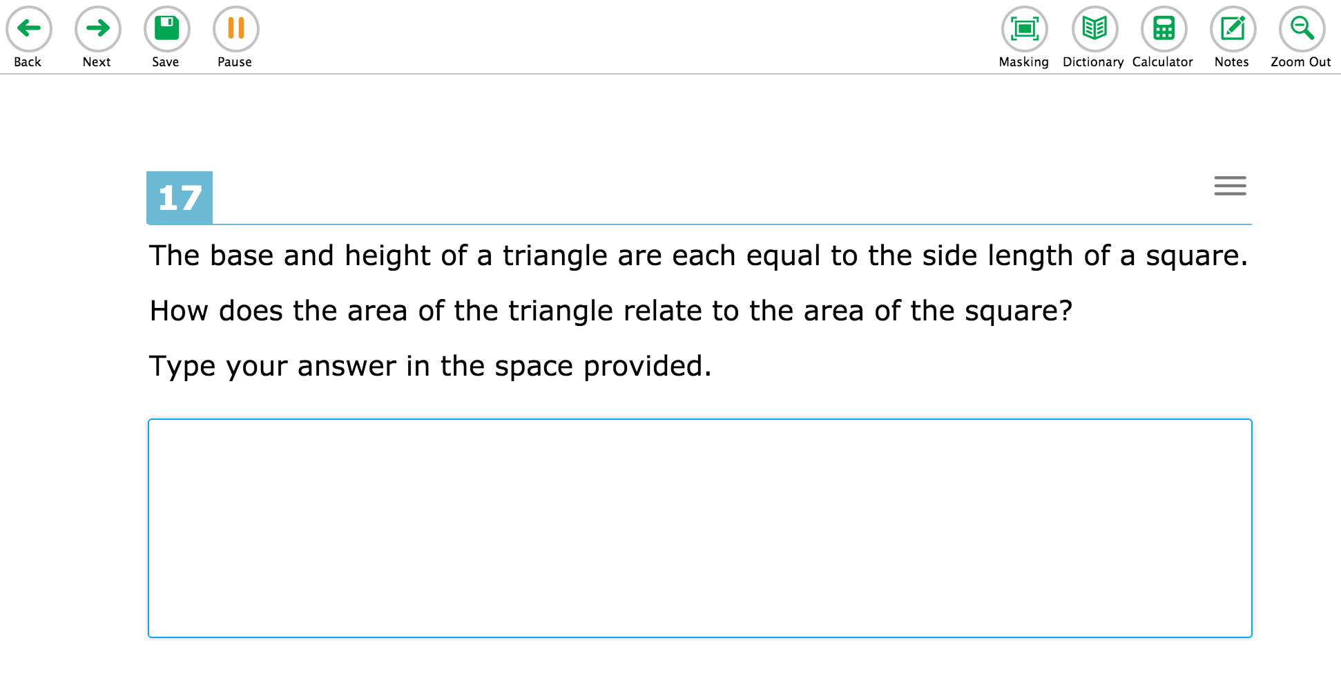
Short Answer

Slide 33
The Reading, Language and Listening Test

Slide 34
Navigation Tips: The Question Map Bar
Use the number to advance question groups. Once the group of questions are answered…hit NEXT.

Slide 35
Maximize the screen using the arrows. This will allow you to see the passage without the questions. Click the arrows to toggle back to see the questions.

Slide 36
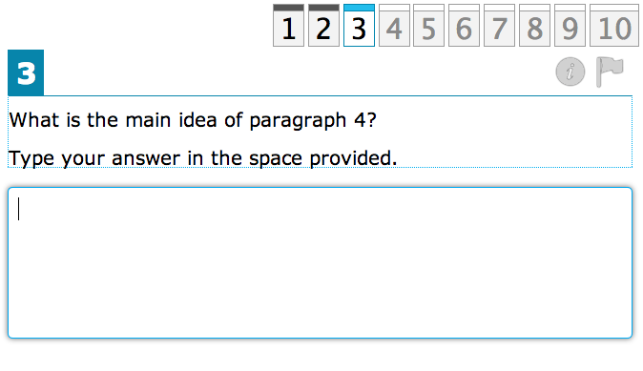
Short Answer!

Slide 37
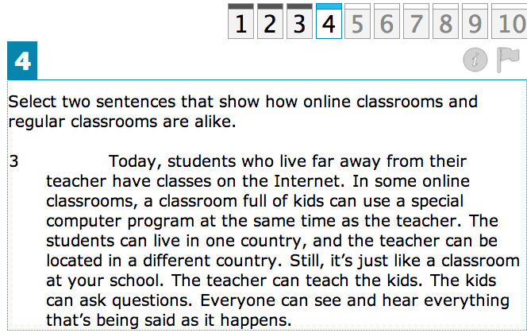
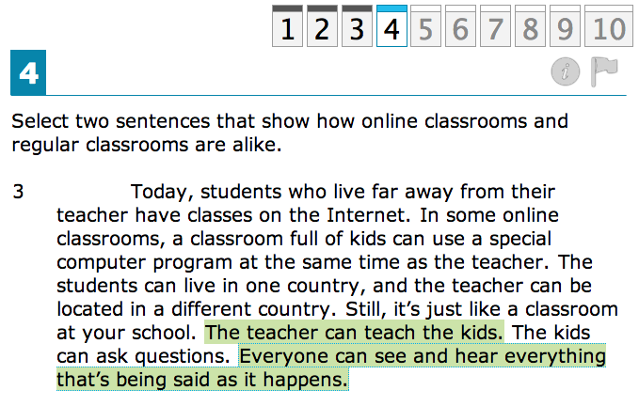
Single/Multiple Answers

Slide 38
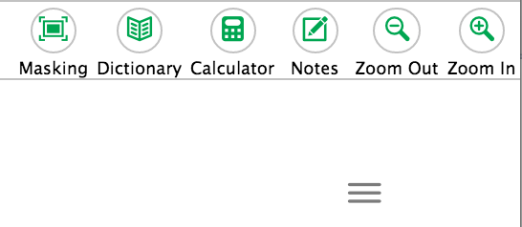
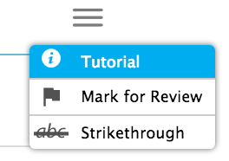
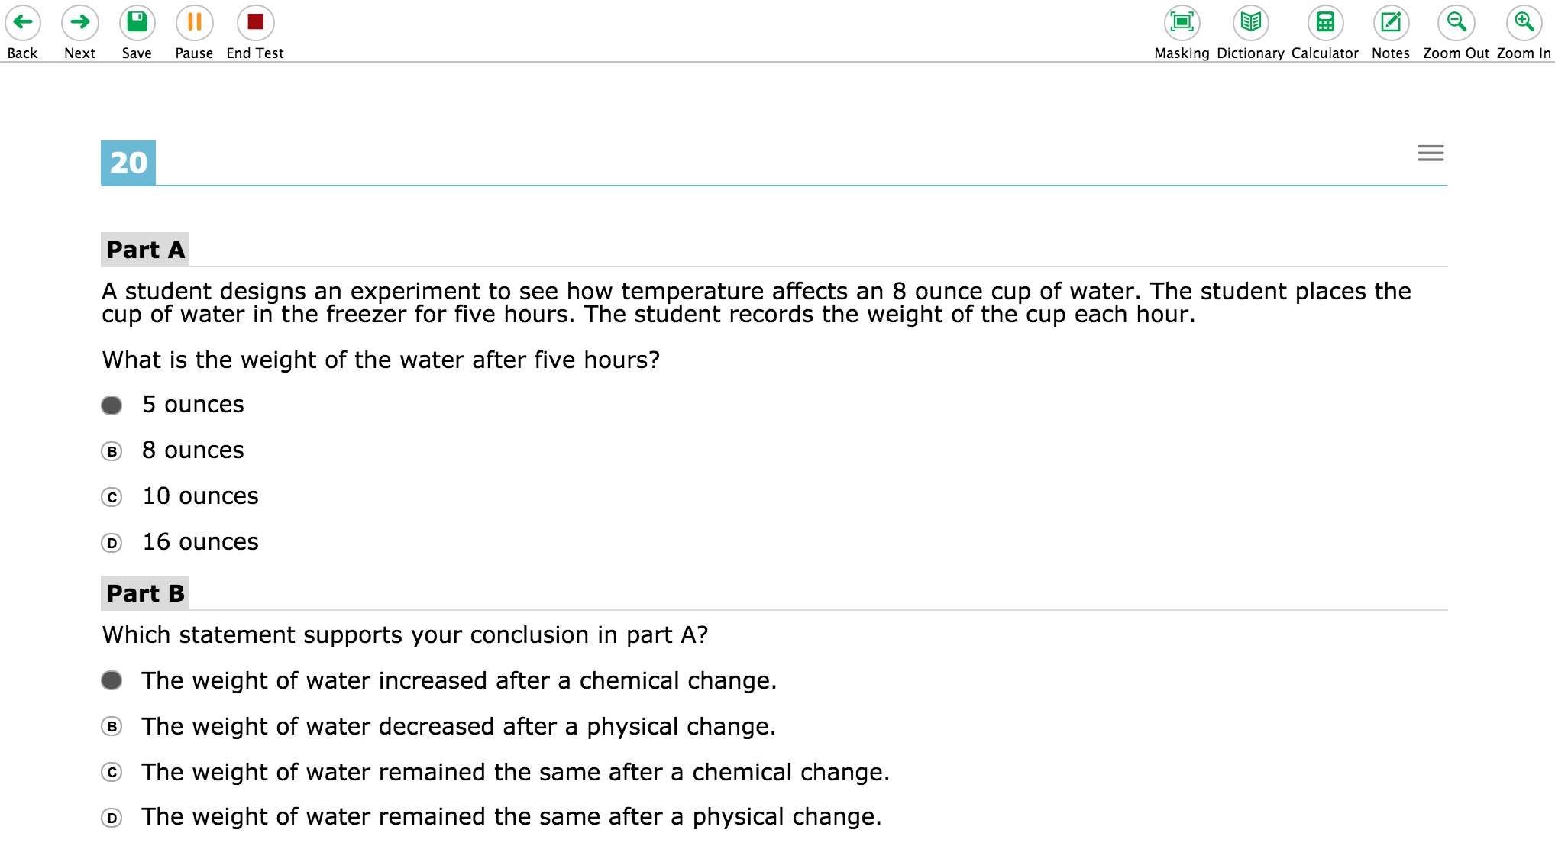
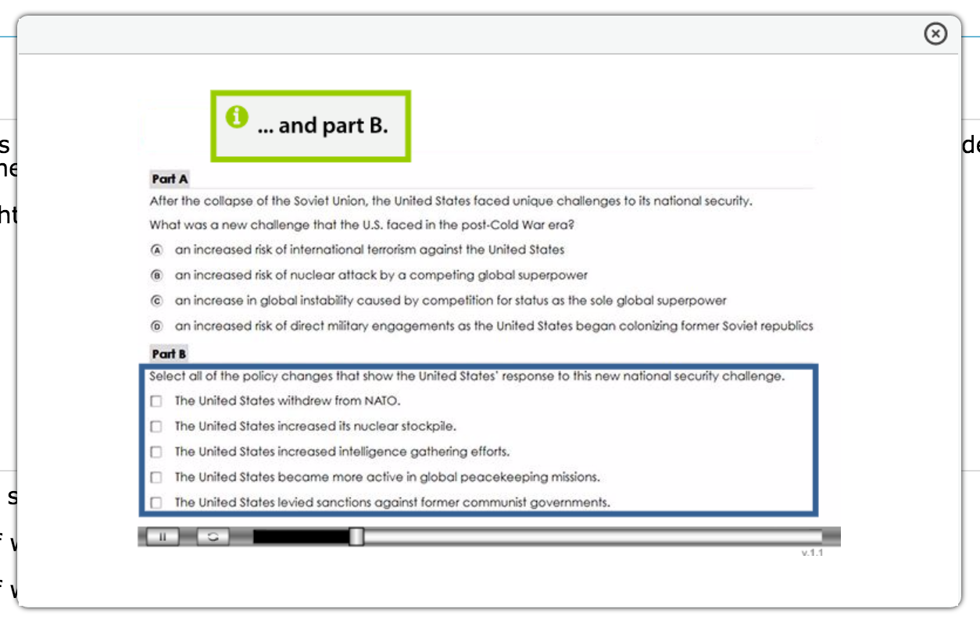
Navigation Tip: The Three Lines!
If you forget what to do, or how a specific section works, just click on the tutorial. An informative movie will begin to play, giving you directions on how to advance through the section.

Slide 39
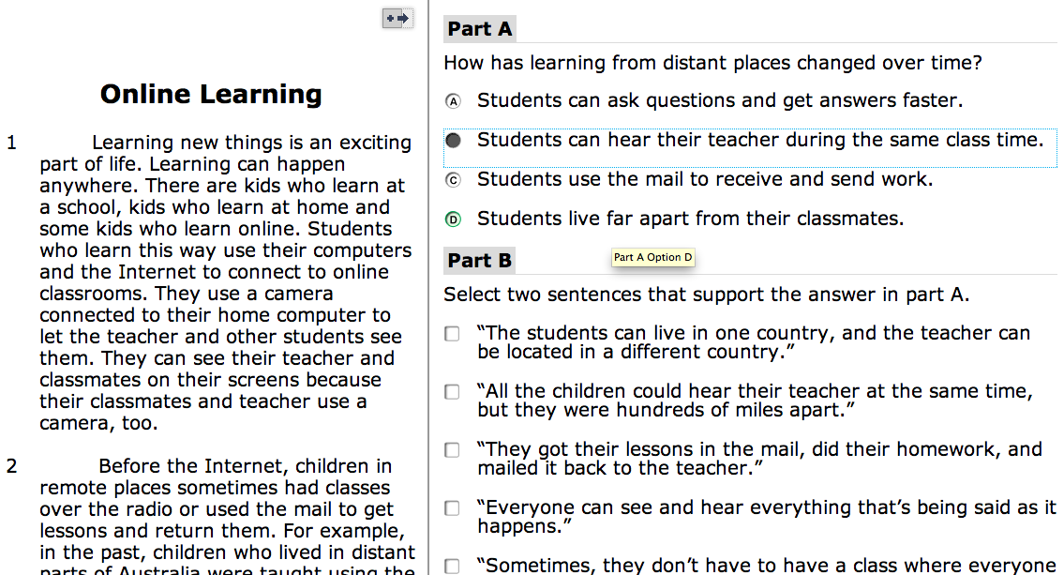
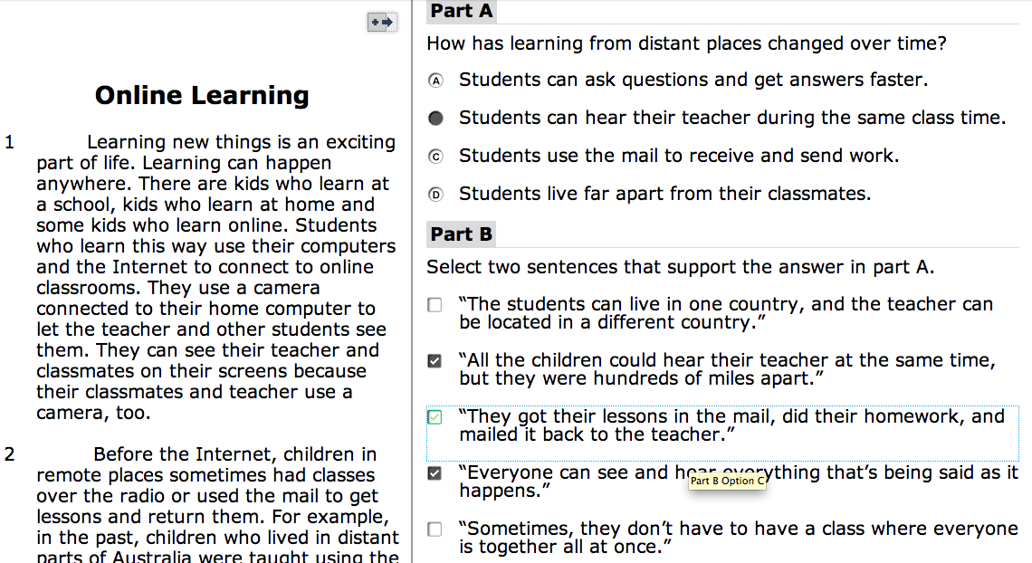
Don’t get tricked! Read the directions! Decide if a single or multiple answer is required.

Slide 40
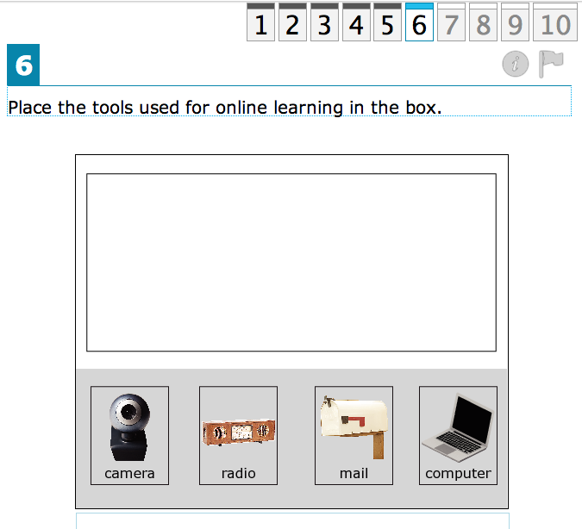
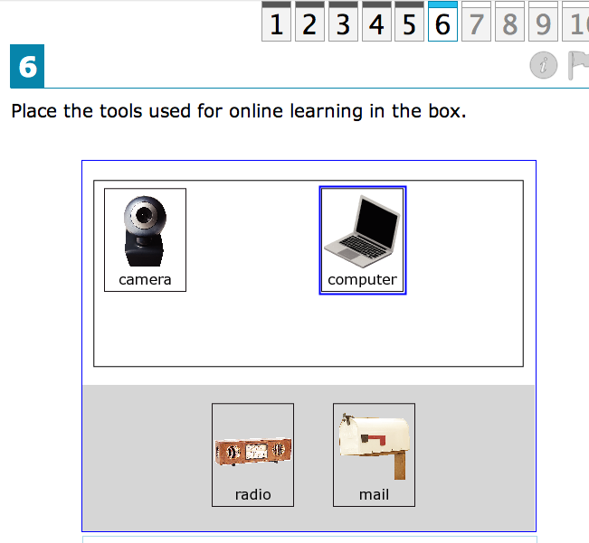
Drag and Drop!

Slide 41
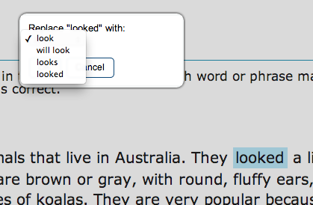
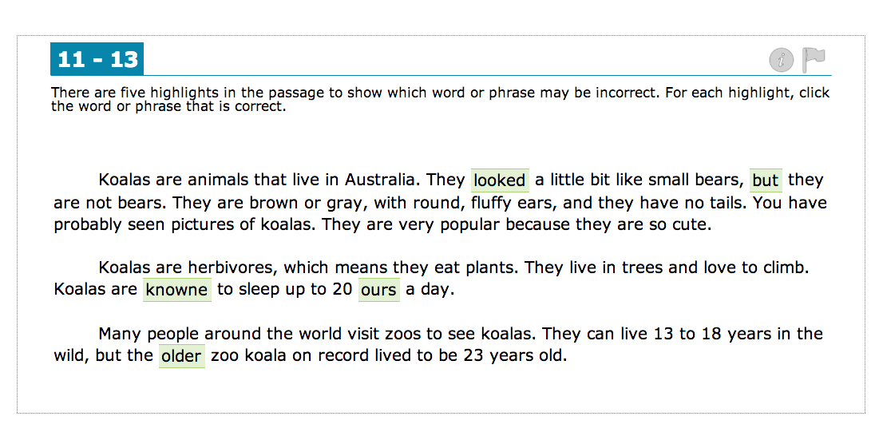
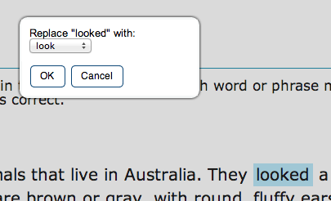
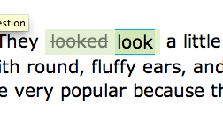
Answer Dropdowns!

Slide 42
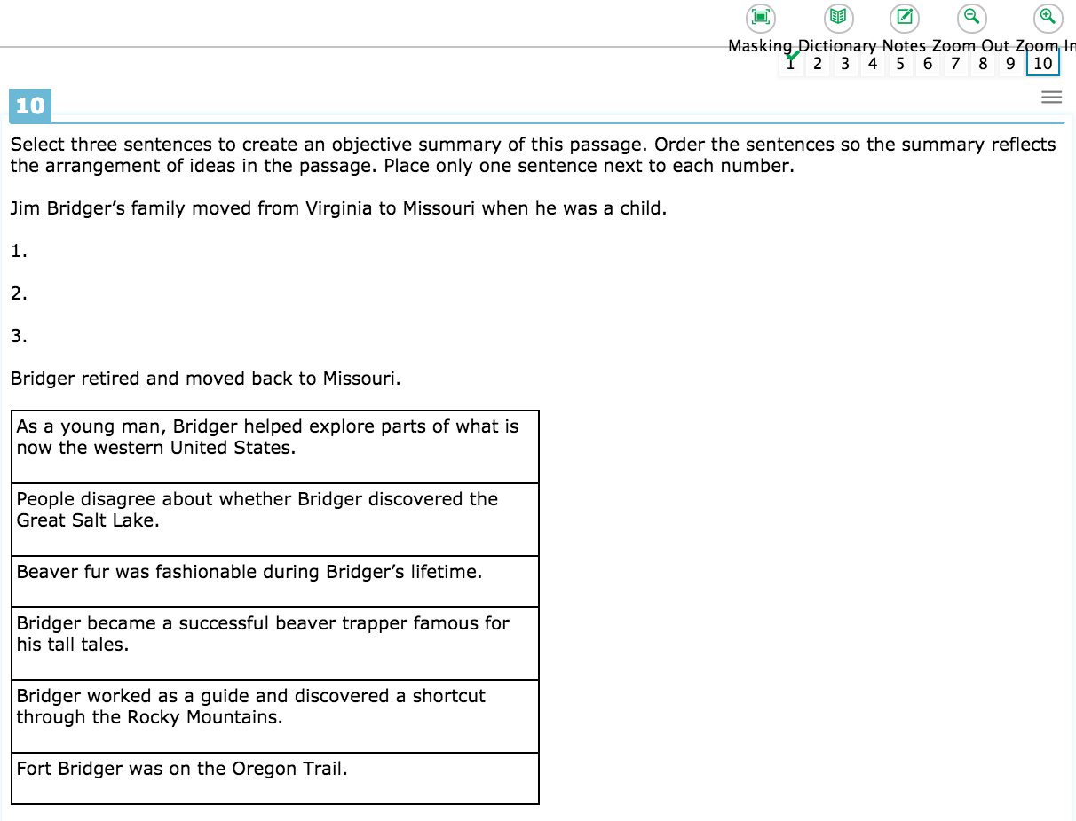
New “Drag To Answer” Feature!

Slide 43
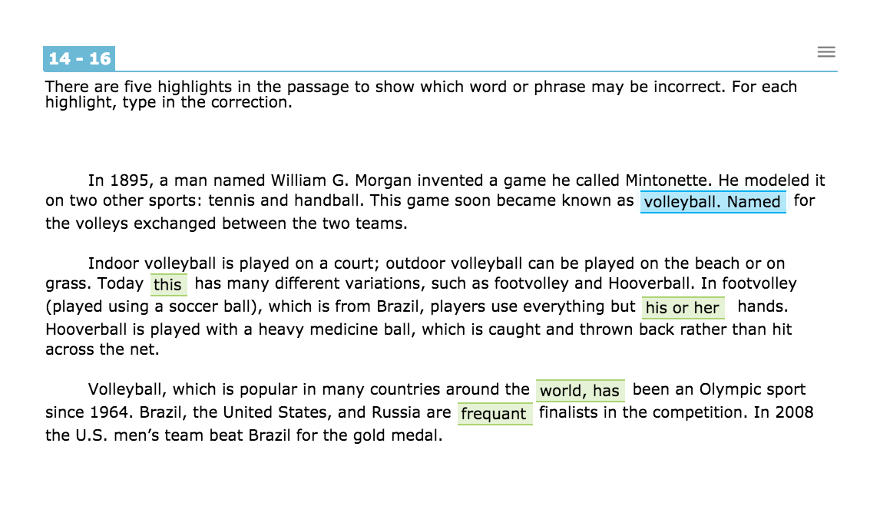
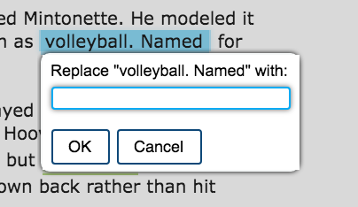
New Fill-in-the-Blank Drop Downs
volleyball, named

Slide 44
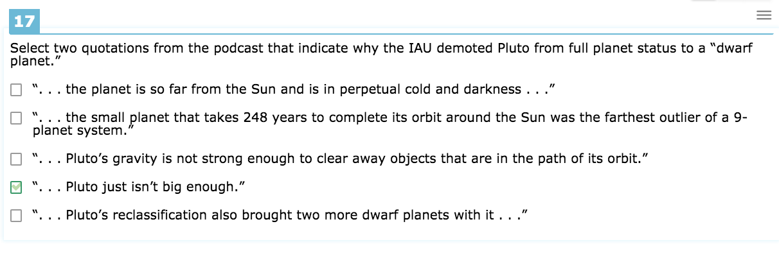
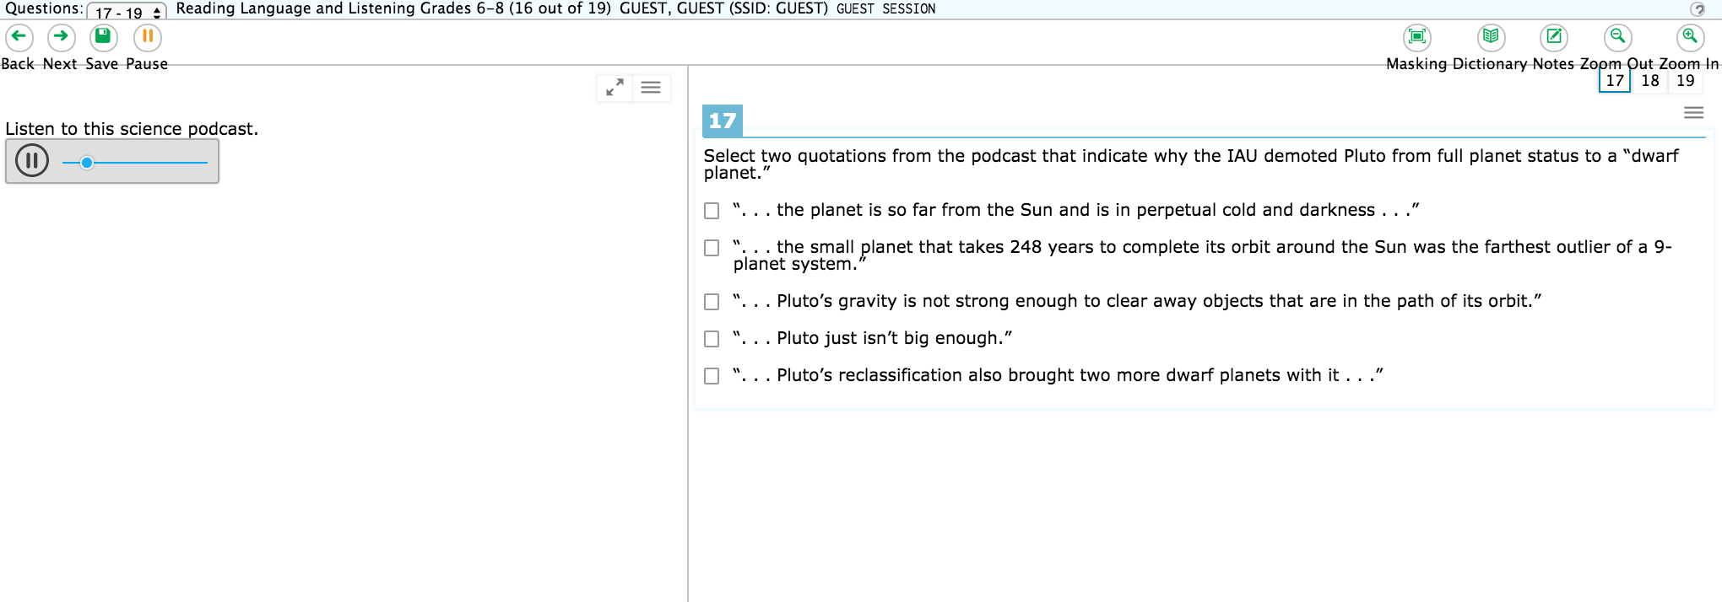
Listening Sections!
Good Testing Tip: Look at the answers BEFORE you listen to the passage. Make a “shopping list” in your brain for what you are looking for!

Slide 45
The Science Test!

Slide 46
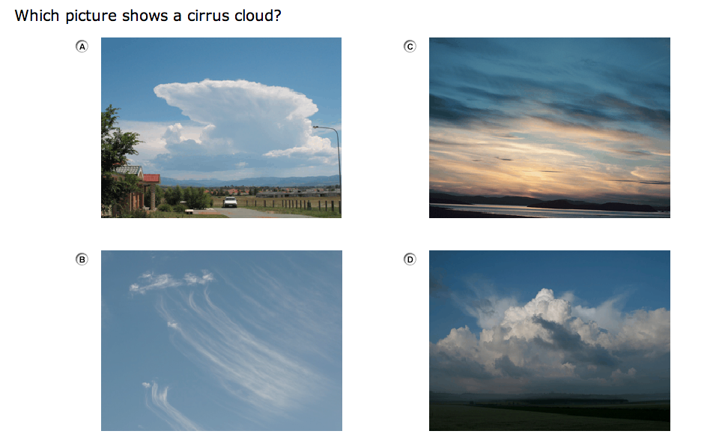
Graphics and Interactives

Slide 47
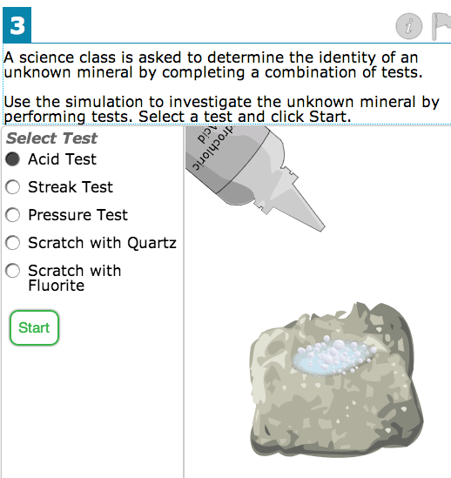
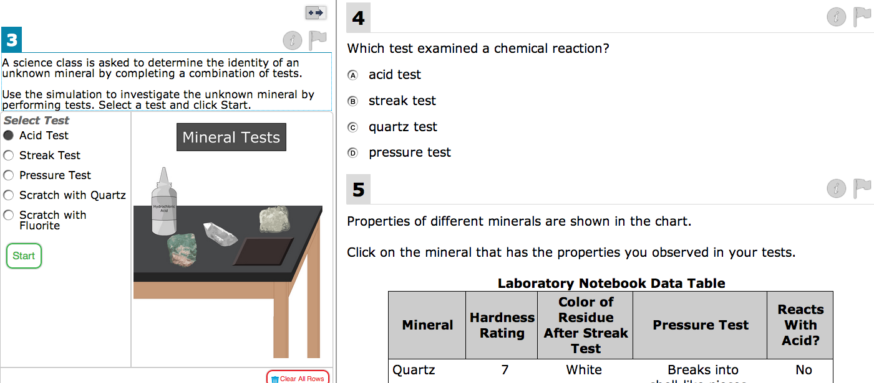
Variety of Questions: Single/Multiple Answers, Drag and Drop, Fill-in-the-Blank, Virtual Experiments

Slide 48
Drag and Drop!

Slide 49
More Drag and Drop!

Slide 50
Interactive questions require you to hover over images to add content and answer the questions!

Slide 51
Multiple Answers!

Slide 52
Short Answer!

Slide 53
Interactive Click and Fill!

Slide 54
Plotting Line Graphs! Add, Delete, Connect Points

Slide 55
Fill-in-the-Blank!
Cloudy

Slide 57
Test Tips!

Slide 58
Test Tips!

Slide 59
Test Tips!

